Slide 1

CS FYP weekly Presentation
Caleb Mok
2689719m
20/11/2024

Slide 2
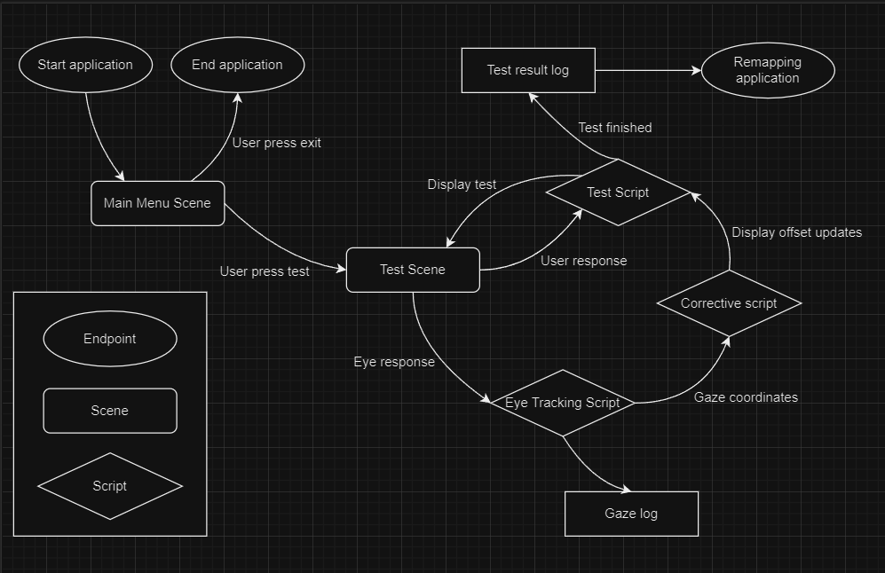
What I had prior and currently trying to do
I’ve started more work on the prototype according to the high-level flow diagram, trying to add a Start Scene that directs the user to the visual testing scene, and other miscellaneous functions and scripts.

Slide 3
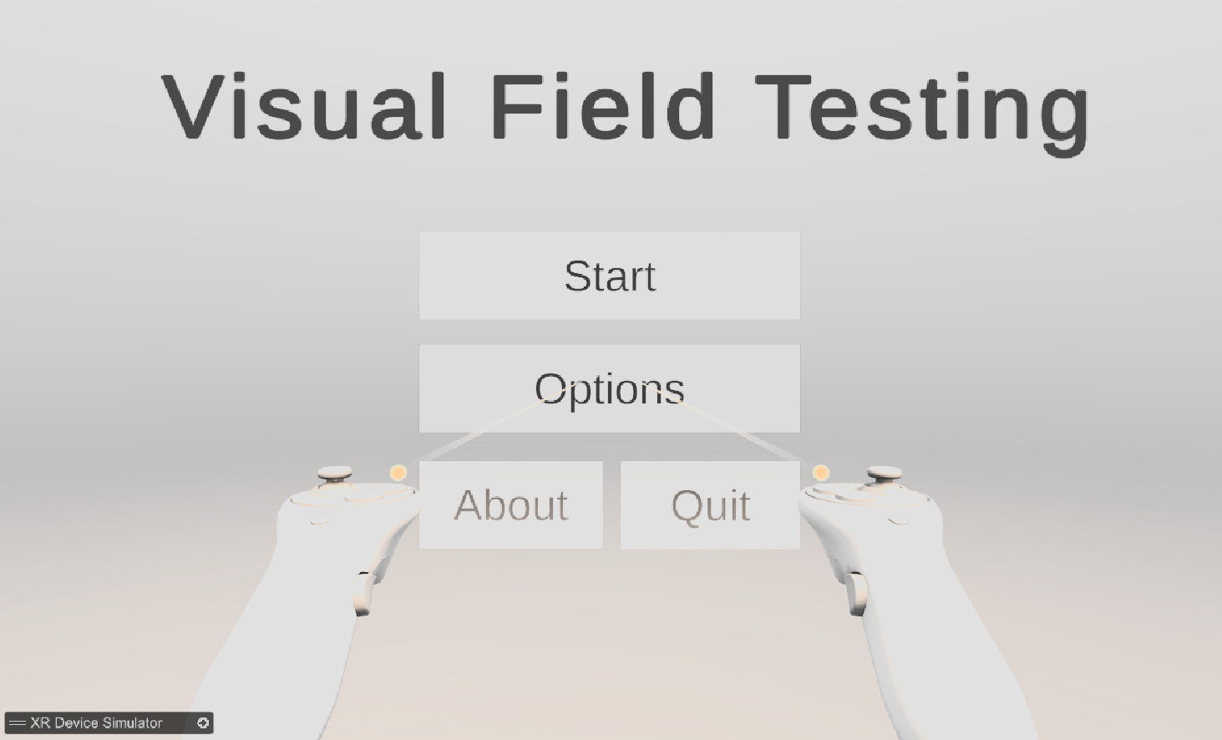
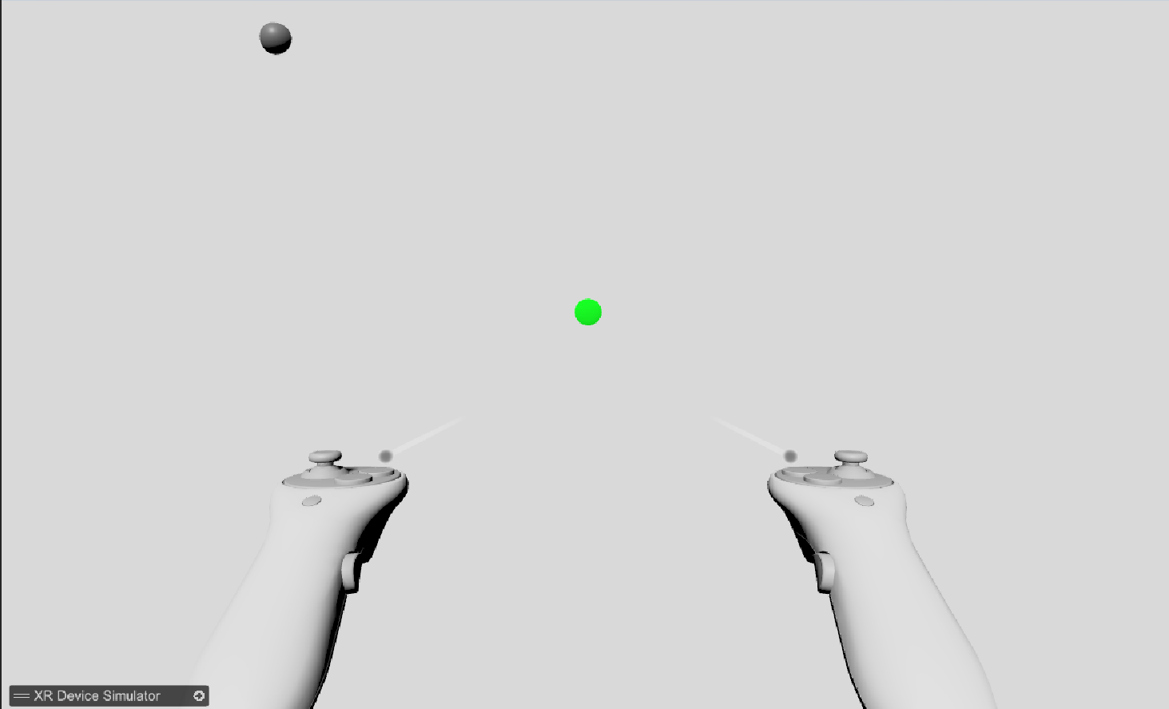
What I achieved this week
I added a Start Scene that directs the user to the visual testing scene after clicking on the start button, and also added other basic buttons such as options, about, and a quit button.
I have also set up a basic proof of concept of the visual field testing, where a small black dot will randomly appear on a white canvas at set intervals.
And did prior installation and initialisation of a database for my project in PostgreSQL.

Slide 4
What I plan to do next
I plan to refine the visual field-testing scene to detect user inputs to start getting usable data and attempt to export the data in a readable format.
Refine the process flow diagram to be more in-depth and make an ER diagram based on that, and finish setting up a database.
Get the VR headset in the lab running so I can start testing my application.
Yet again, pester the helpdesk for the software (or just use the other stations)

Slide 5
Literature Review

Slide 6
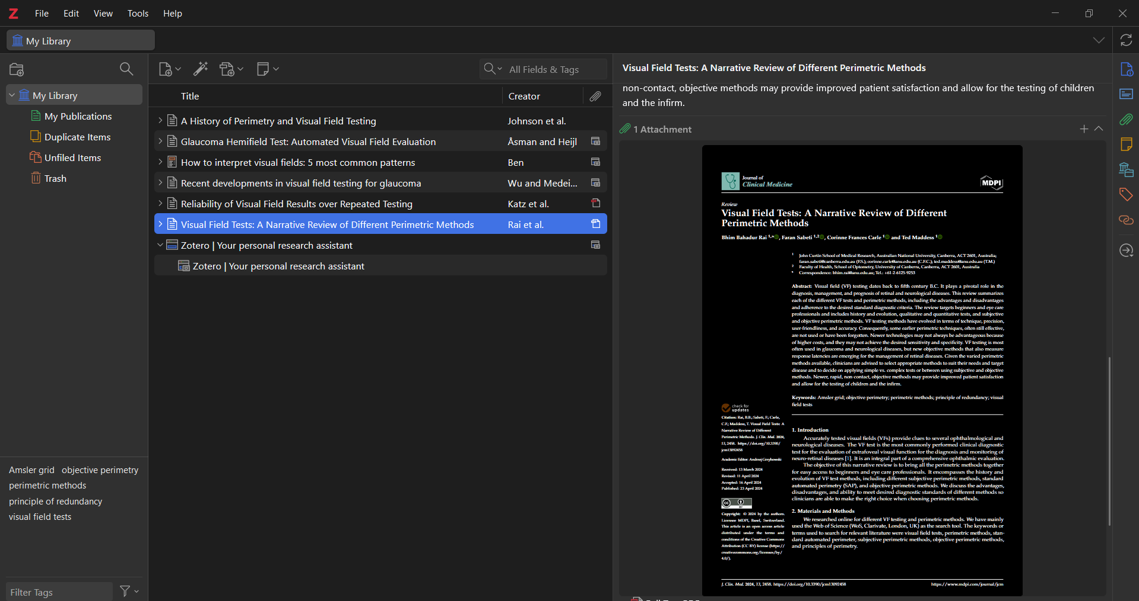
What I achieved this week
I’ve reorganized my literature review, and successfully set up a reference manager (Zotero) to link with Overleaf for easier referencing in the future. I’ve also added a few papers that I’ve briefly read through and deemed important into my review. Some papers I’ve not added into the review, but they are saved in Zotero, and I will analyse them further.
I’ve also started work on making a basic high-level process flow diagram for my project, designed different scenes I expect my project to have and also the scripts needed to run the project.

Slide 7
What I am trying to do

